Slide 1



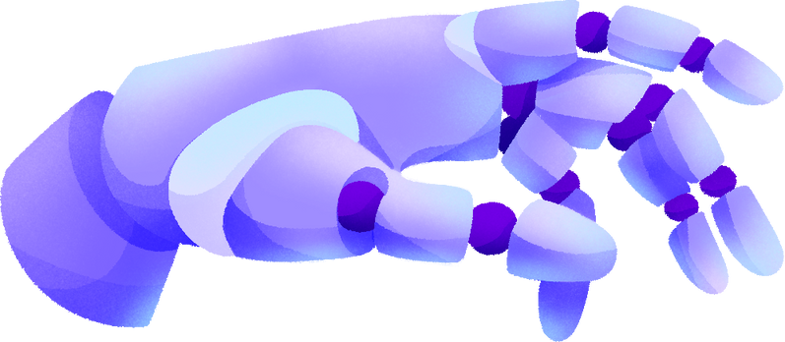
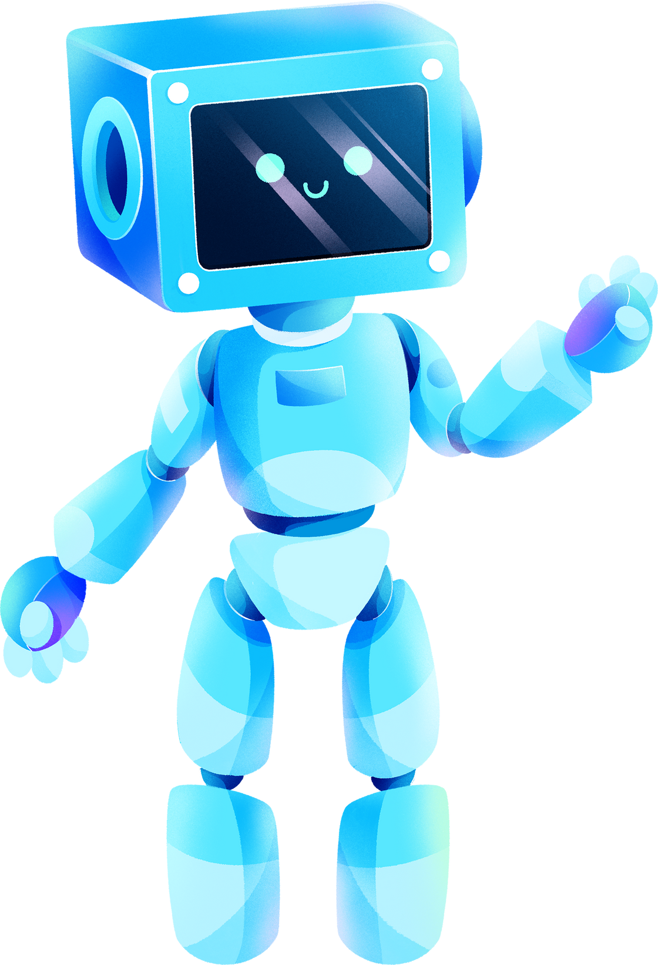
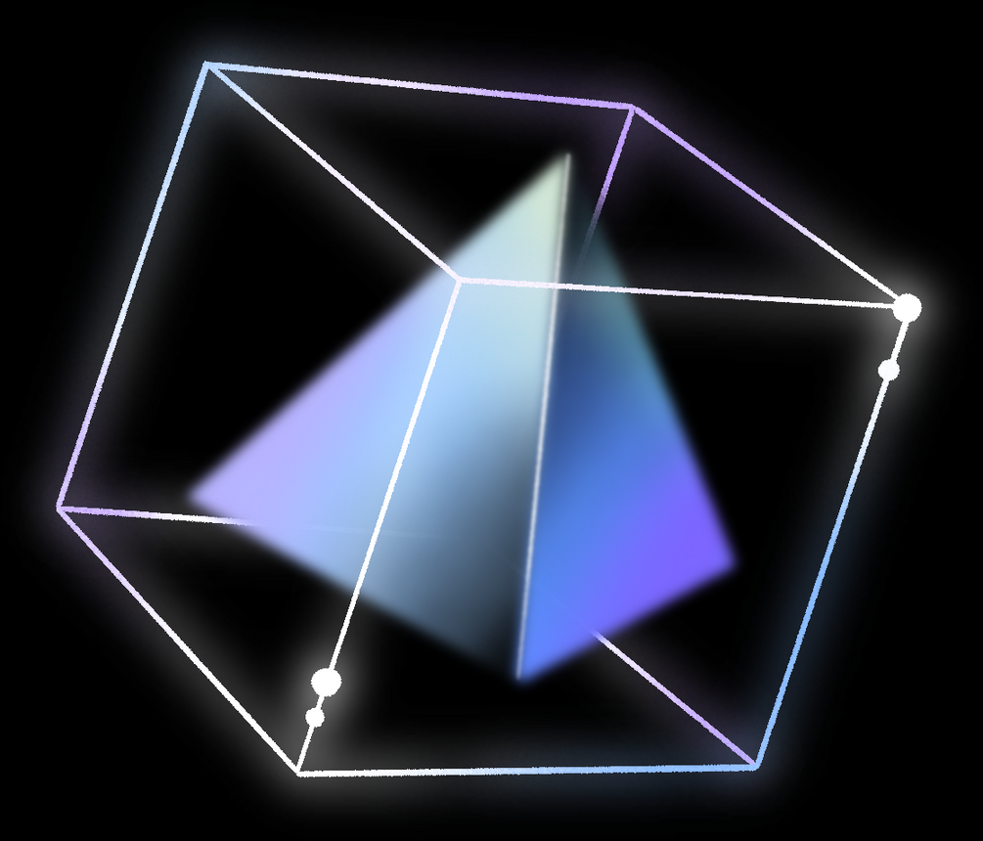
IoT & ROBOTICS
WORKSHOP

Slide 2

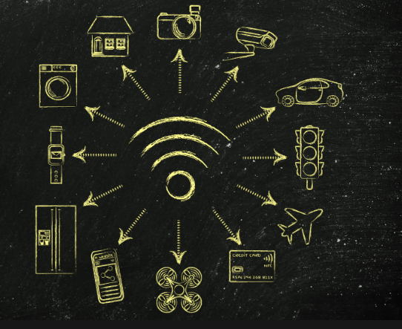
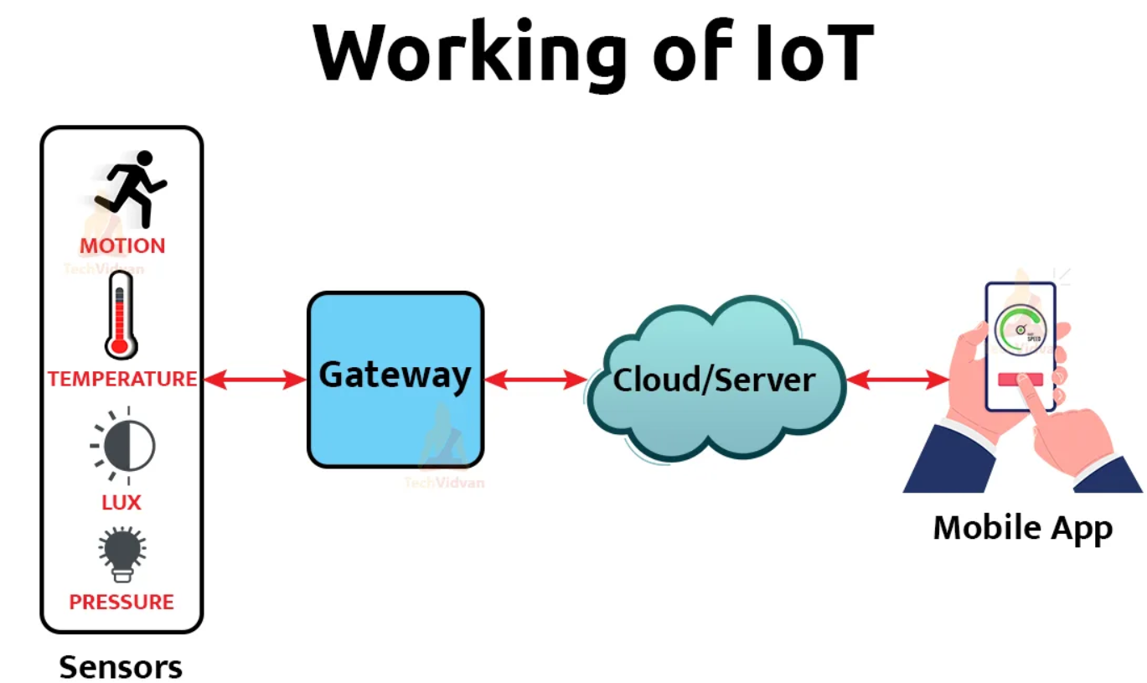
What is IoT?
IoT, or Internet of Things, means connecting everyday objects to the internet, like fan or lights, to make them smart and controllable.

Slide 3
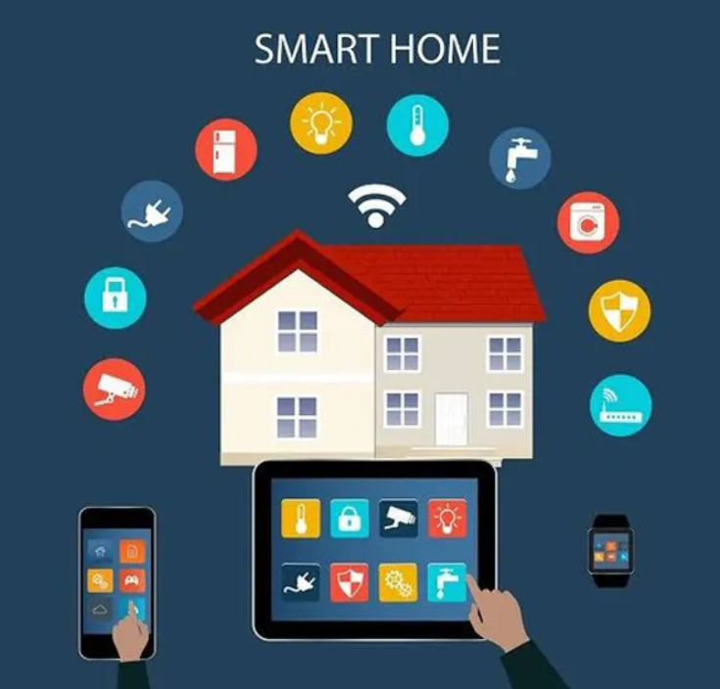
Why IoT is important?
The Internet of Things (IoT) gives everyday objects magical abilities by connecting them to the internet. Lights turn on automatically, fridges remind you of groceries, and fan become interactive wonders!

Slide 4
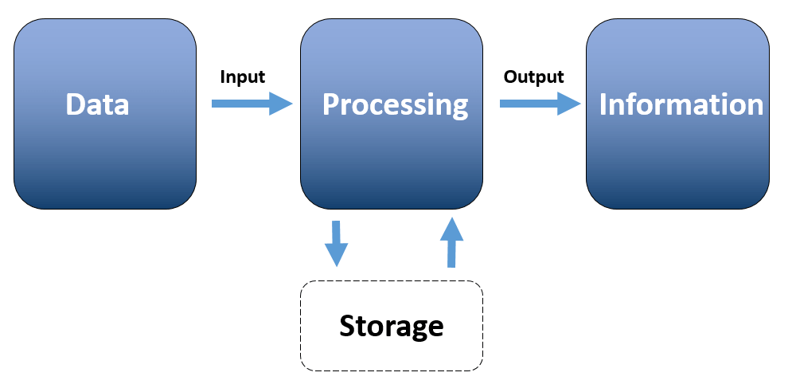
How do IoT Devices Work?
IoT devices function with embedded processing for data handling, network adapters for communication, and unique IP addresses for identification, managed through dedicated software applications.

Slide 5
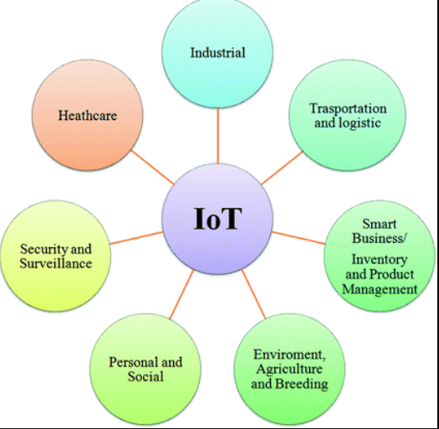
Application of IOT

Slide 6
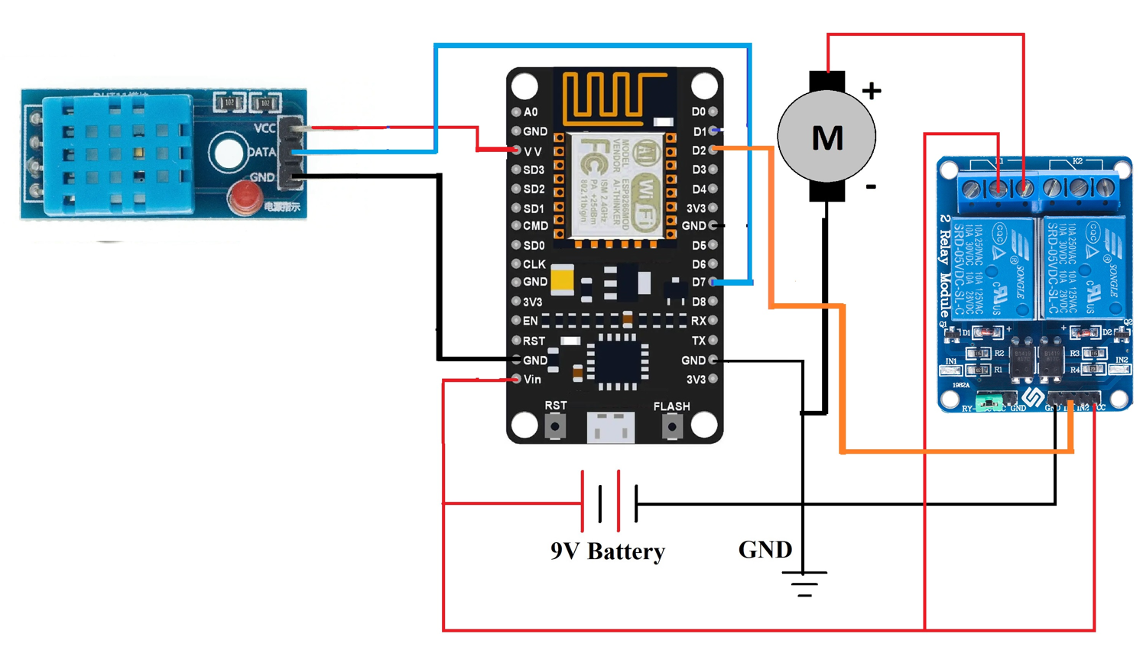

Environmental Monitoring System
F

Slide 7
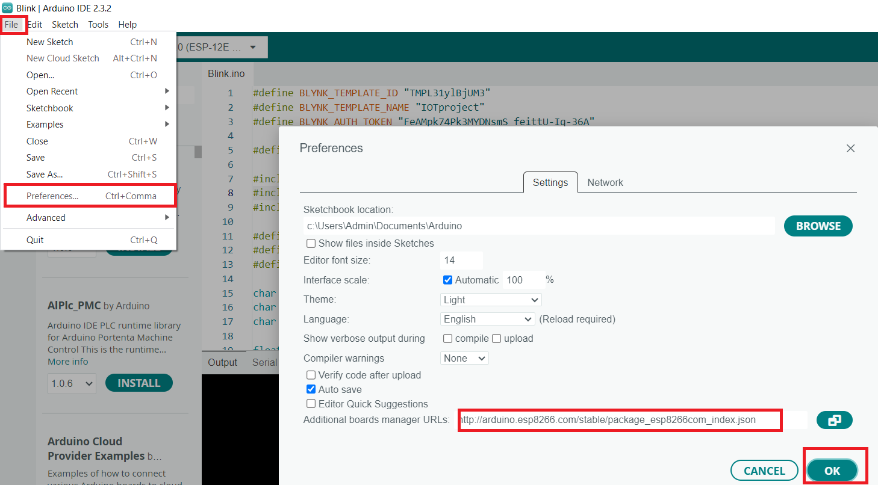
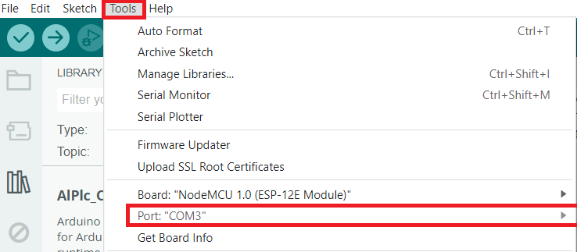
Arduino IDE Configuration
http://arduino.esp8266.com/stable/package_esp8266com_index.json

Slide 8

BLYNK IoT Web
Blynk Iot Website
https://blynk.io/

Slide 9
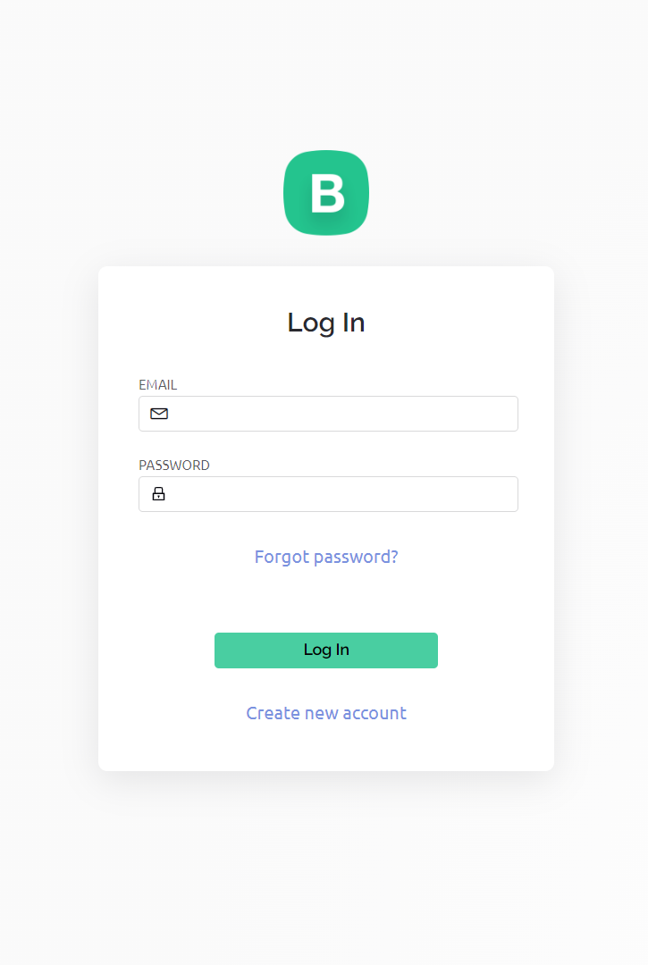
Blynk Website - https://blynk.io/
BLYNK IoT Web
Blynk is a tool that lets you connect and control devices, like lights or robots, using buttons and screens on your phone or computer.
Create a new Blynk account
>>>>Click “create new account”

Slide 10
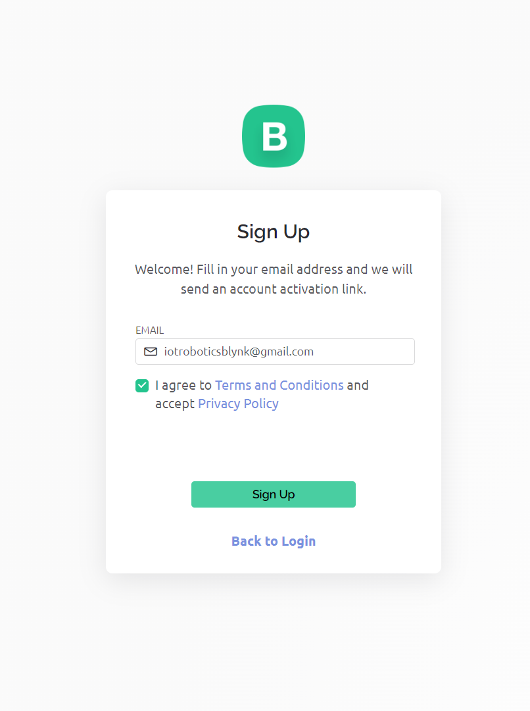
Blynk Website - https://blynk.io/
BLYNK IoT Web
Blynk is a tool that lets you connect and control devices, like lights or robots, using buttons and screens on your phone or computer.
>>>> Now enter your “email id”
>>>> Click “sign up”

Slide 11
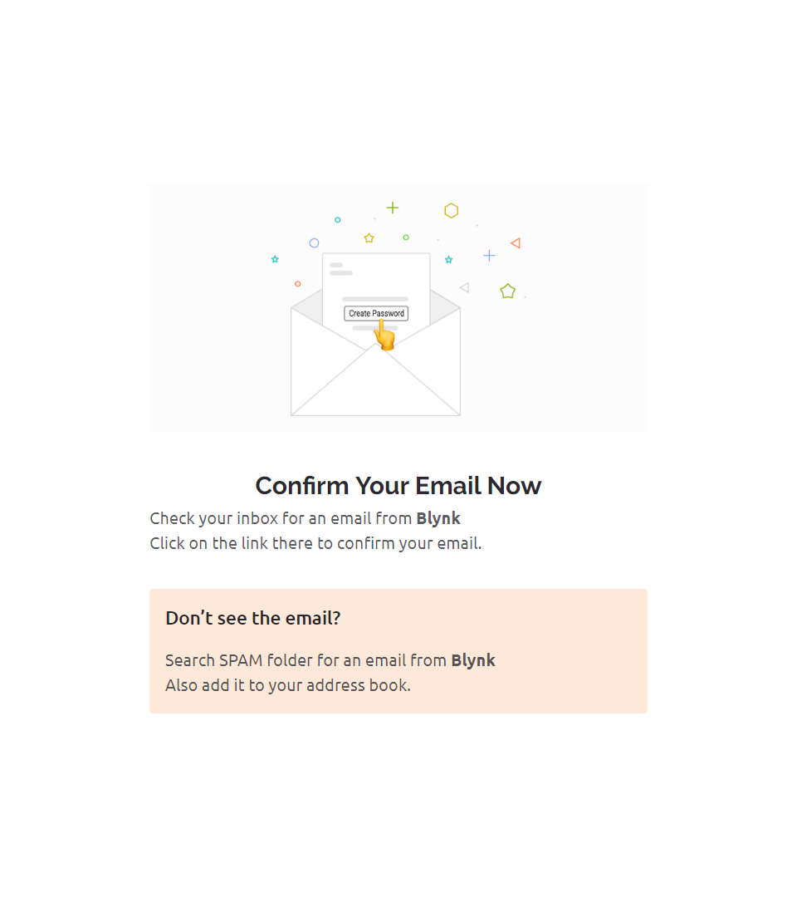
Blynk Website - https://blynk.io/
BLYNK IoT Web
Blynk is a tool that lets you connect and control devices, like lights or robots, using buttons and screens on your phone or computer.
>>>>Now check your mail inbox

Slide 12
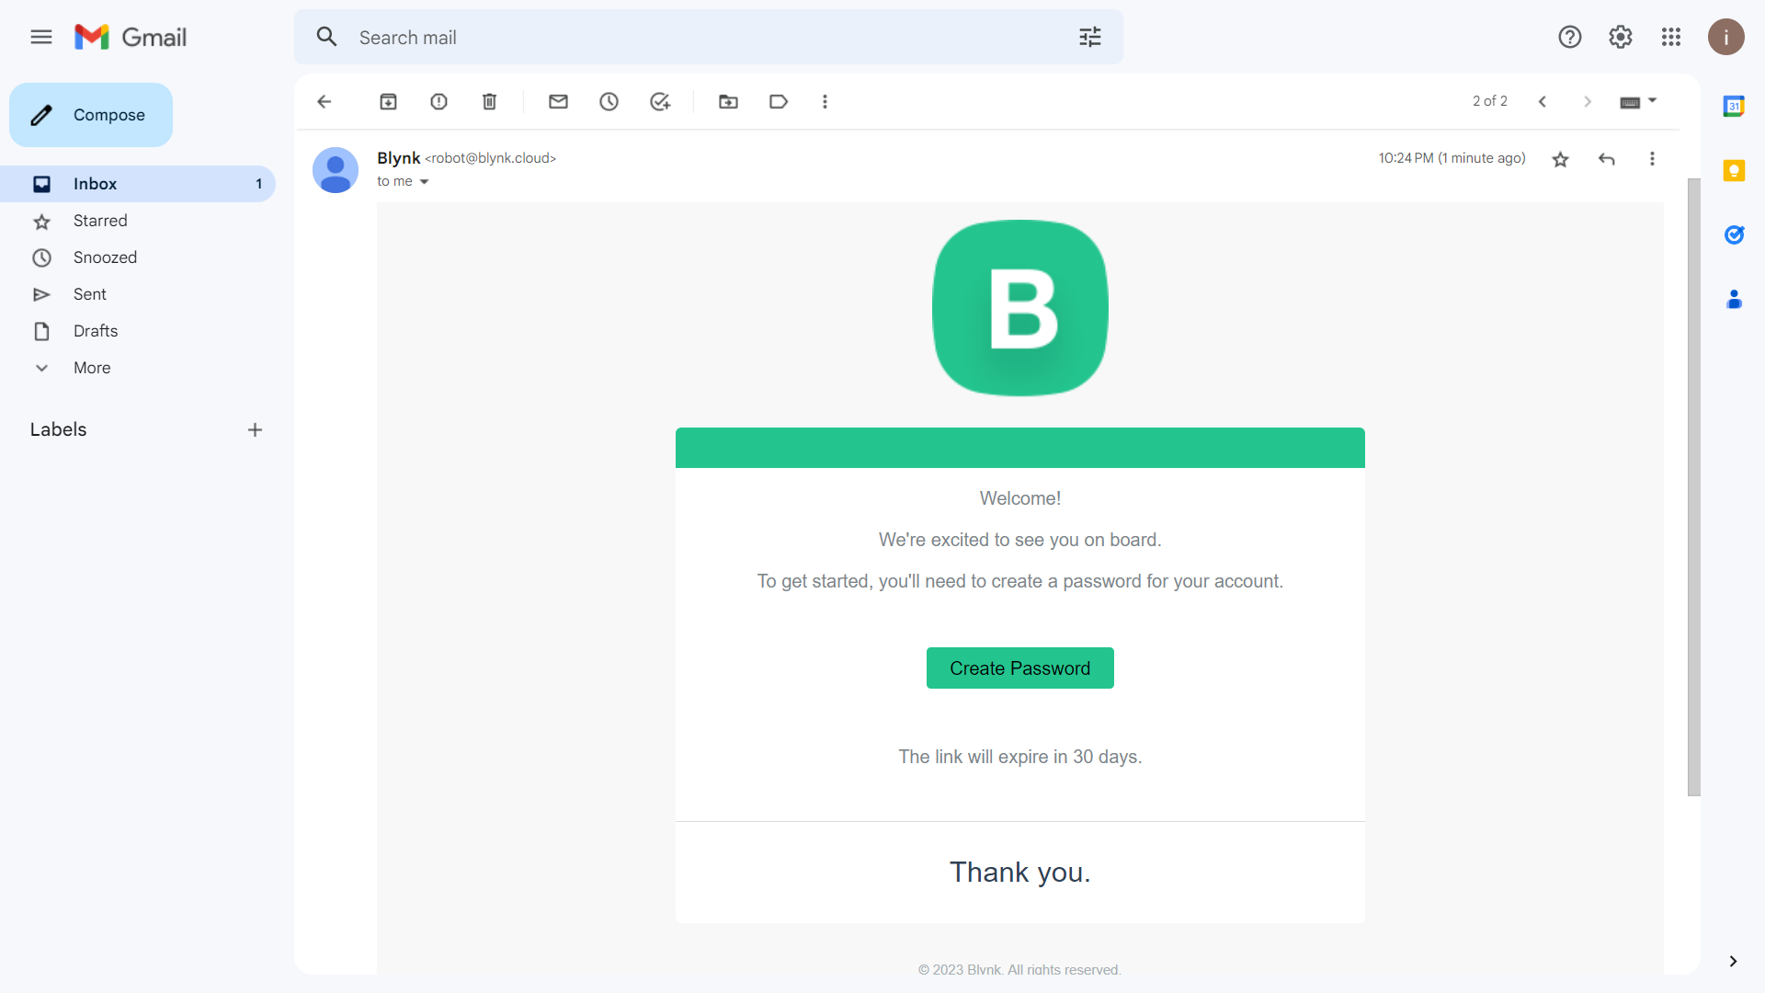
Blynk Website - https://blynk.io/
BLYNK IoT Web
Blynk is a tool that lets you connect and control devices, like lights or robots, using buttons and screens on your phone or computer.

Slide 13
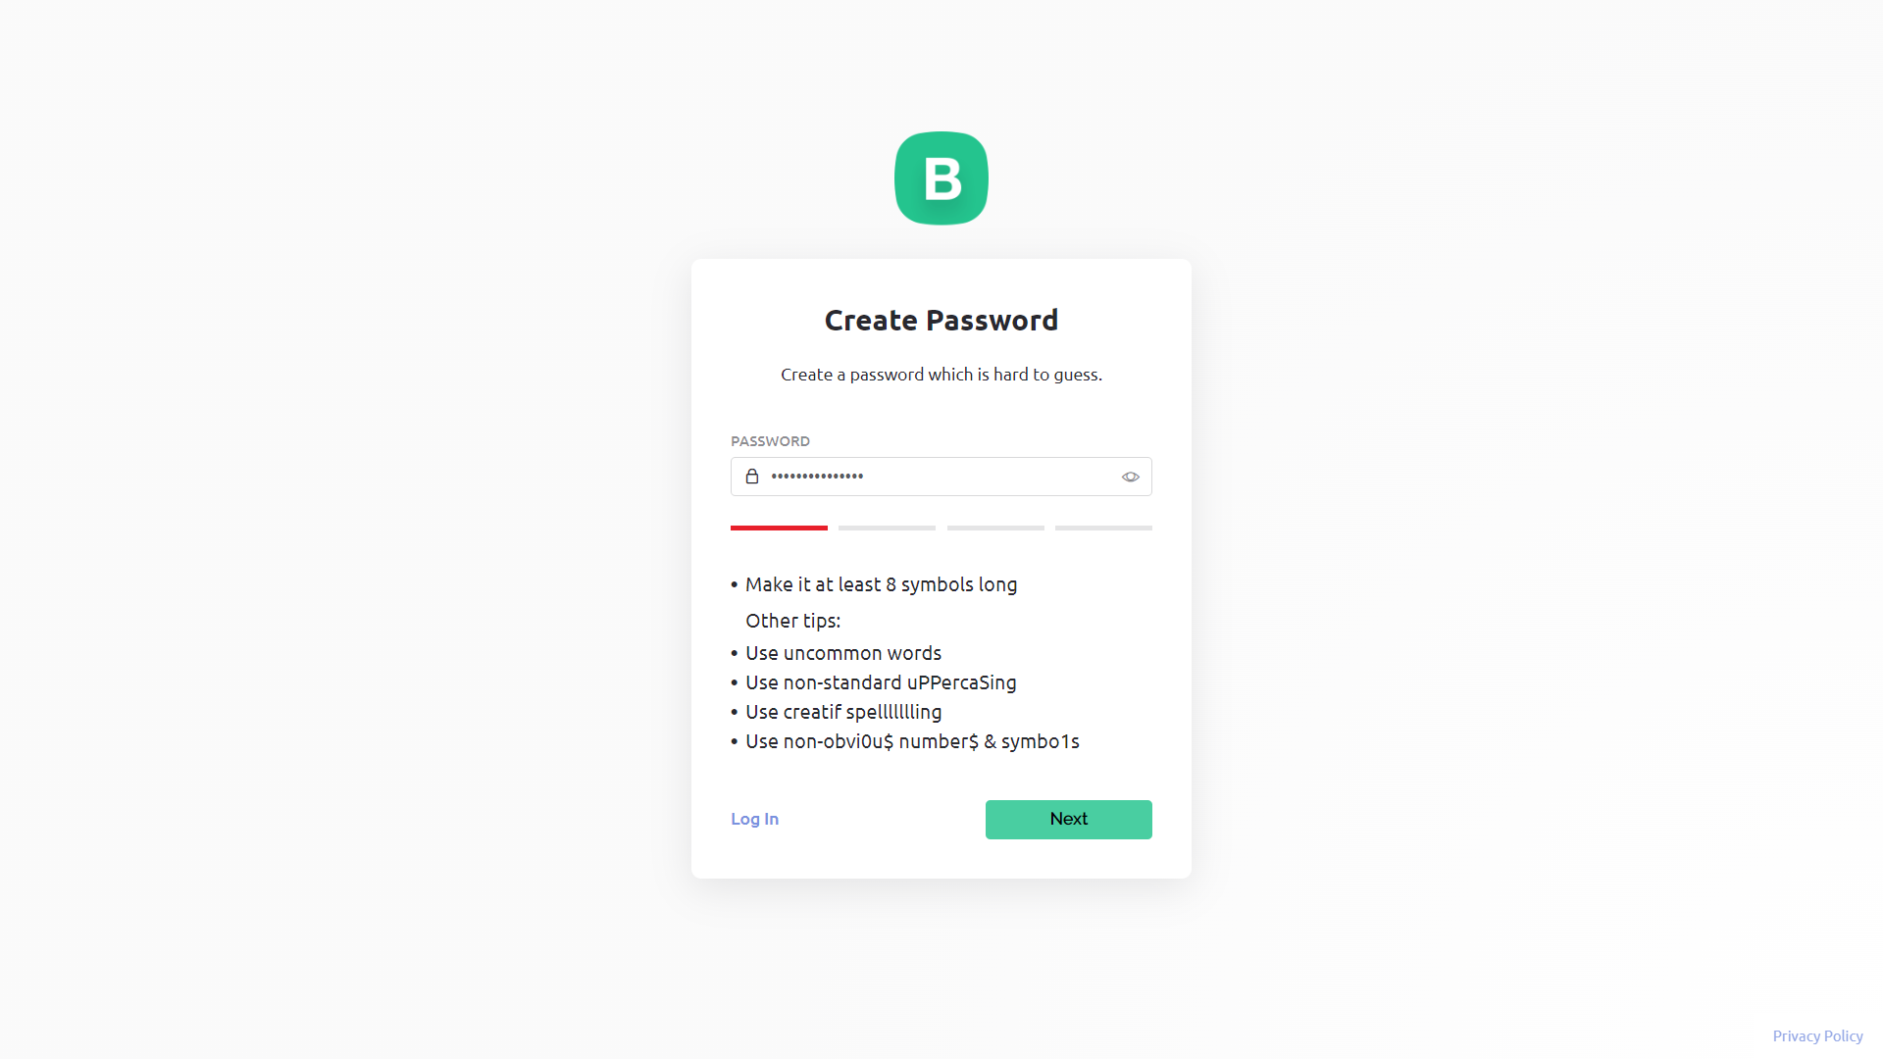
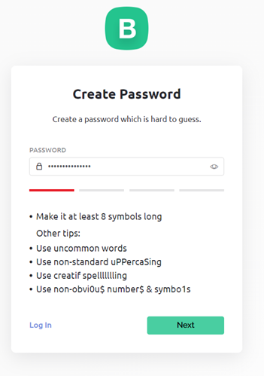
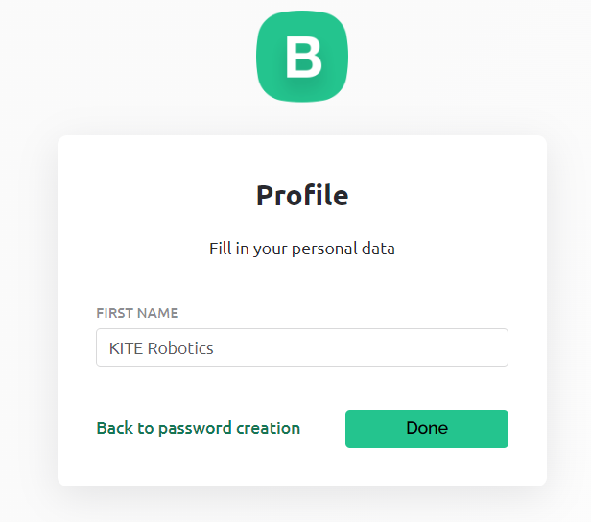
Blynk Website - https://blynk.io/
BLYNK IoT Web
After creating password >>>> Click “Next” >>>> Then type your profile name….
Blynk is a tool that lets you connect and control devices, like lights or robots, using buttons and screens on your phone or computer.

Slide 14
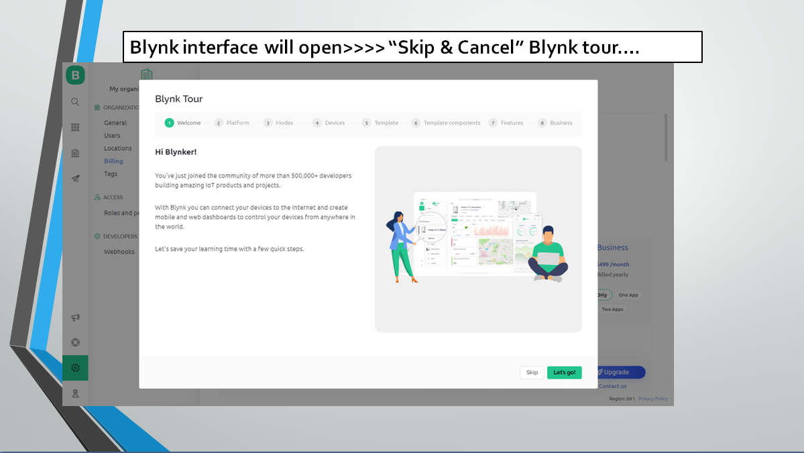
Blynk Website - https://blynk.io/
BLYNK IoT Web
Blynk is a tool that lets you connect and control devices, like lights or robots, using buttons and screens on your phone or computer.

Slide 15
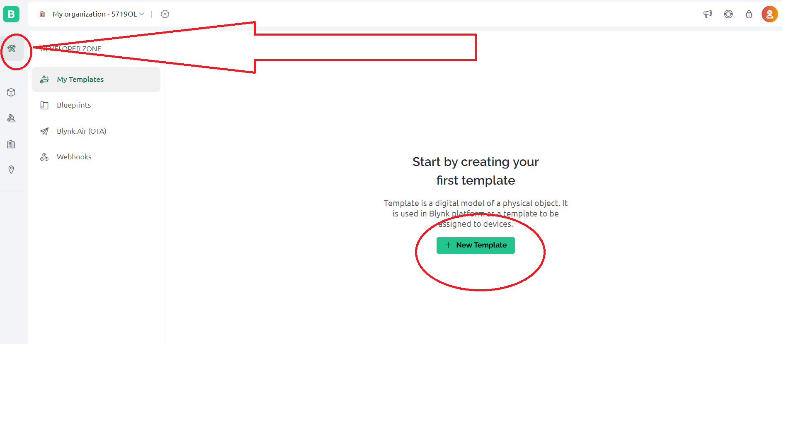
Blynk Website - https://blynk.io/
BLYNK IoT Web
Blynk is a tool that lets you connect and control devices, like lights or robots, using buttons and screens on your phone or computer.
First create template >>>> Click Developer Zone “New Template Tab”

Slide 16
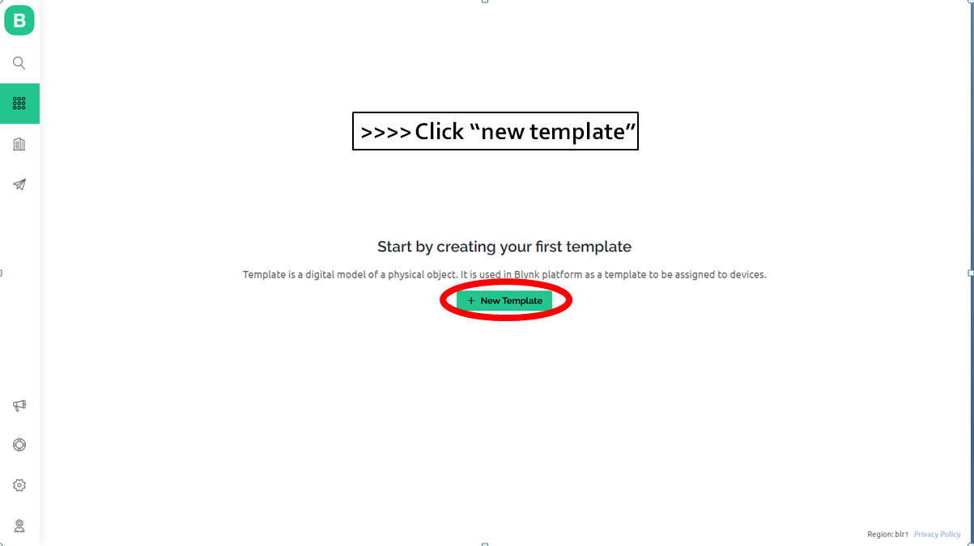
Blynk Website - https://blynk.io/
BLYNK IoT Web
Blynk is a tool that lets you connect and control devices, like lights or robots, using buttons and screens on your phone or computer.

Slide 17
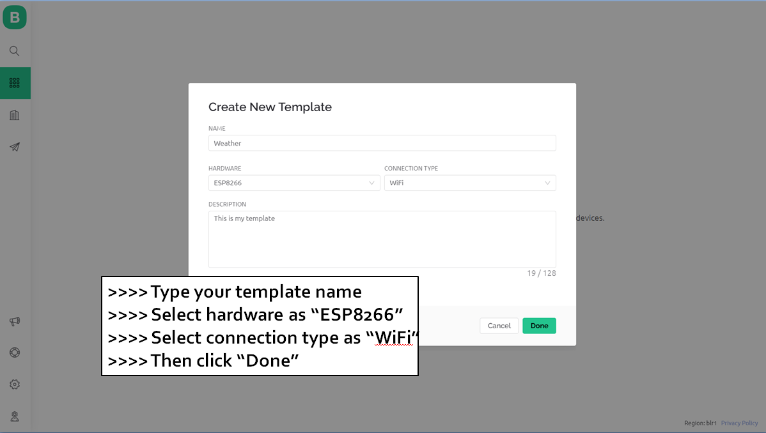
Blynk Website - https://blynk.io/
BLYNK IoT Web
Blynk is a tool that lets you connect and control devices, like lights or robots, using buttons and screens on your phone or computer.

Slide 18
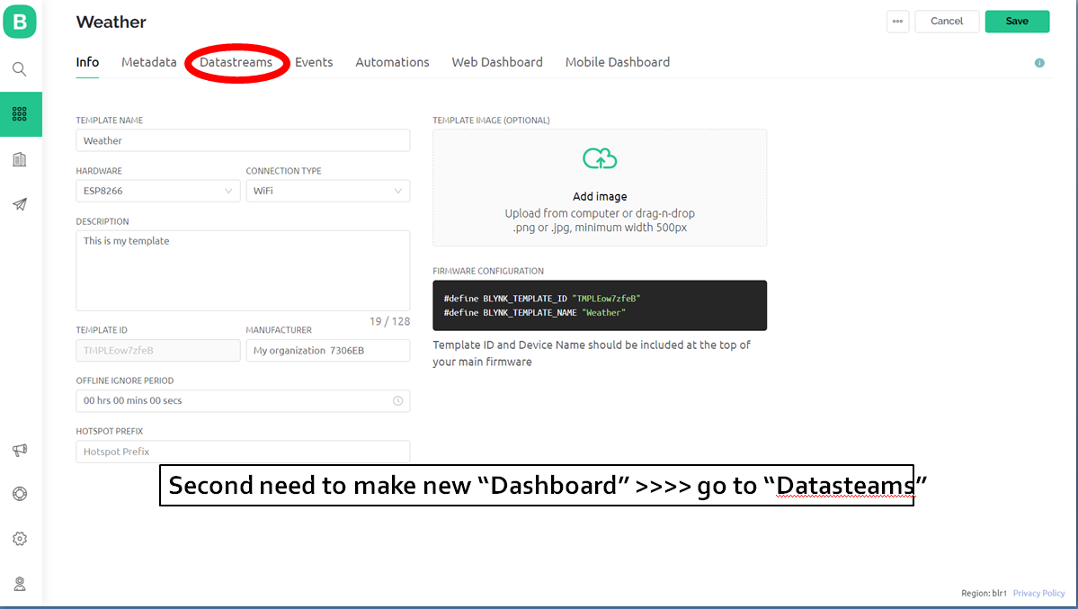
Blynk Website - https://blynk.io/
BLYNK IoT Web
Blynk is a tool that lets you connect and control devices, like lights or robots, using buttons and screens on your phone or computer.

Slide 19
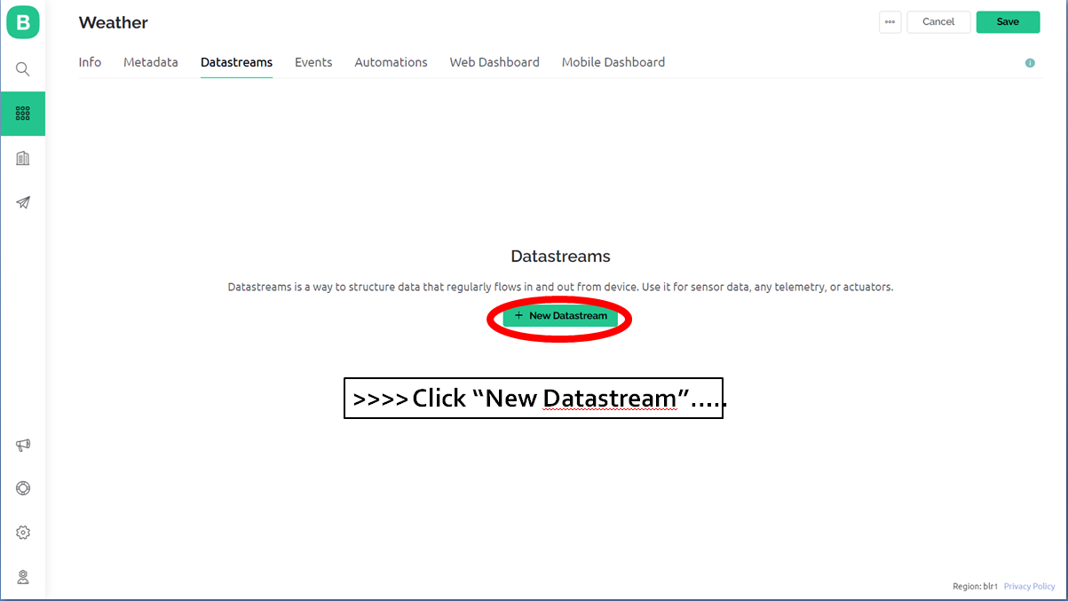
Blynk Website - https://blynk.io/
BLYNK IoT Web
Blynk is a tool that lets you connect and control devices, like lights or robots, using buttons and screens on your phone or computer.

Slide 20
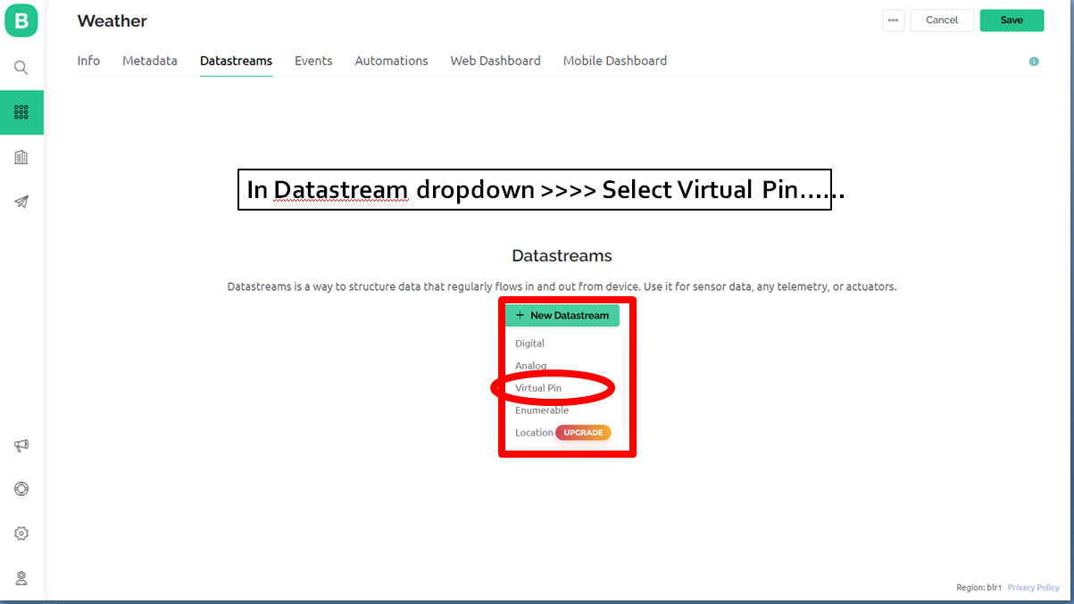
Blynk Website - https://blynk.io/
BLYNK IoT Web
Blynk is a tool that lets you connect and control devices, like lights or robots, using buttons and screens on your phone or computer.

Slide 21
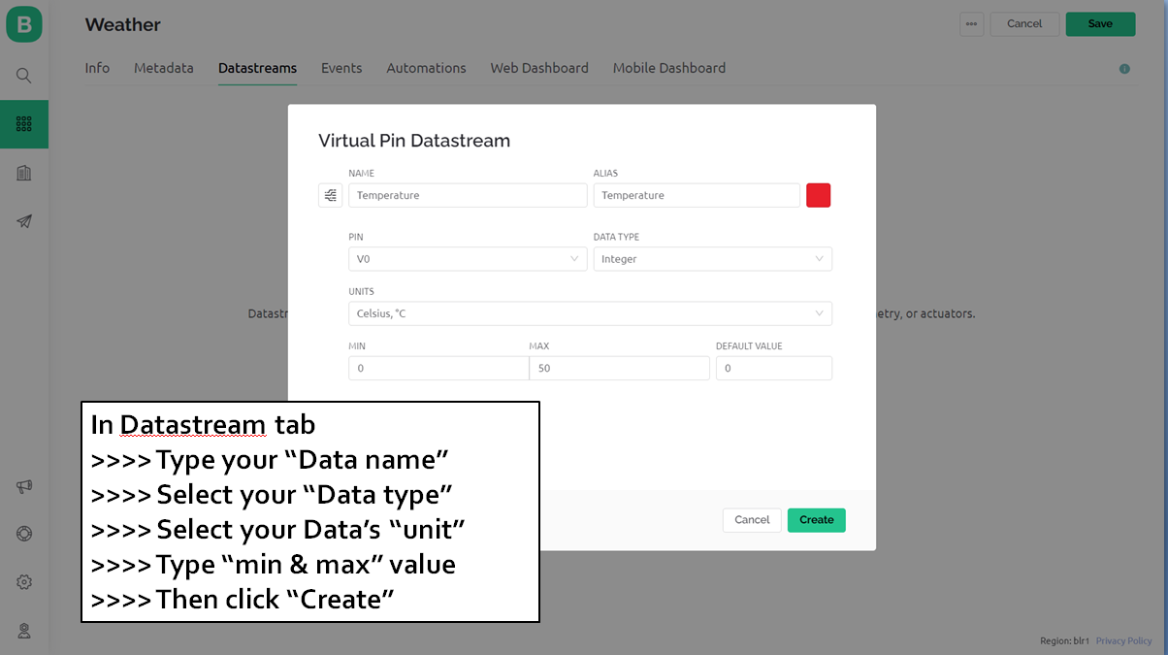
Blynk Website - https://blynk.io/
BLYNK IoT Web
Blynk is a tool that lets you connect and control devices, like lights or robots, using buttons and screens on your phone or computer.

Slide 22
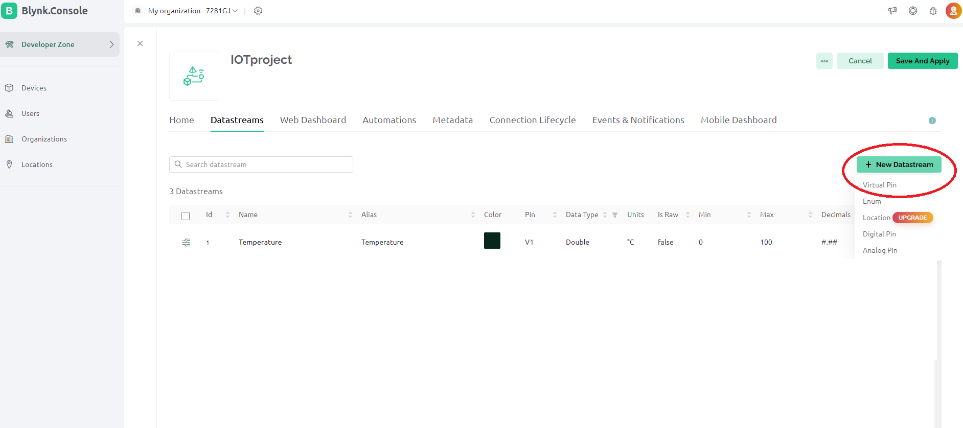
Blynk Website - https://blynk.io/
BLYNK IoT Web
Blynk is a tool that lets you connect and control devices, like lights or robots, using buttons and screens on your phone or computer.
>>>> click “New Datastream”
>>>> Then click ‘’Virtual Pin’’

Slide 23
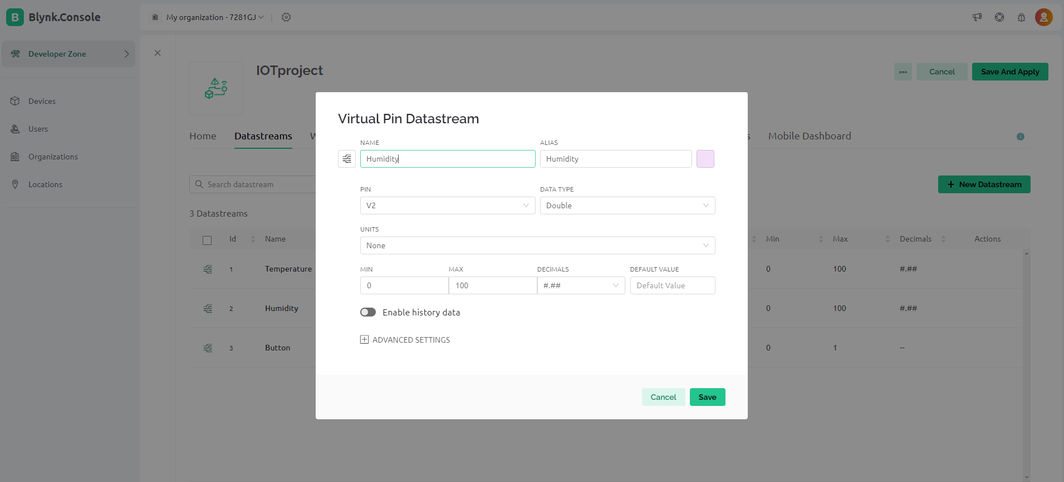
Blynk Website - https://blynk.io/
BLYNK IoT Web
Blynk is a tool that lets you connect and control devices, like lights or robots, using buttons and screens on your phone or computer.
In Datastream tab
>>>> Type your “Data name”
>>>> Select your “Data type”
>>>> Select your Data’s “unit”
>>>> Type “min & max” value
>>>> Then click “Create”

Slide 24
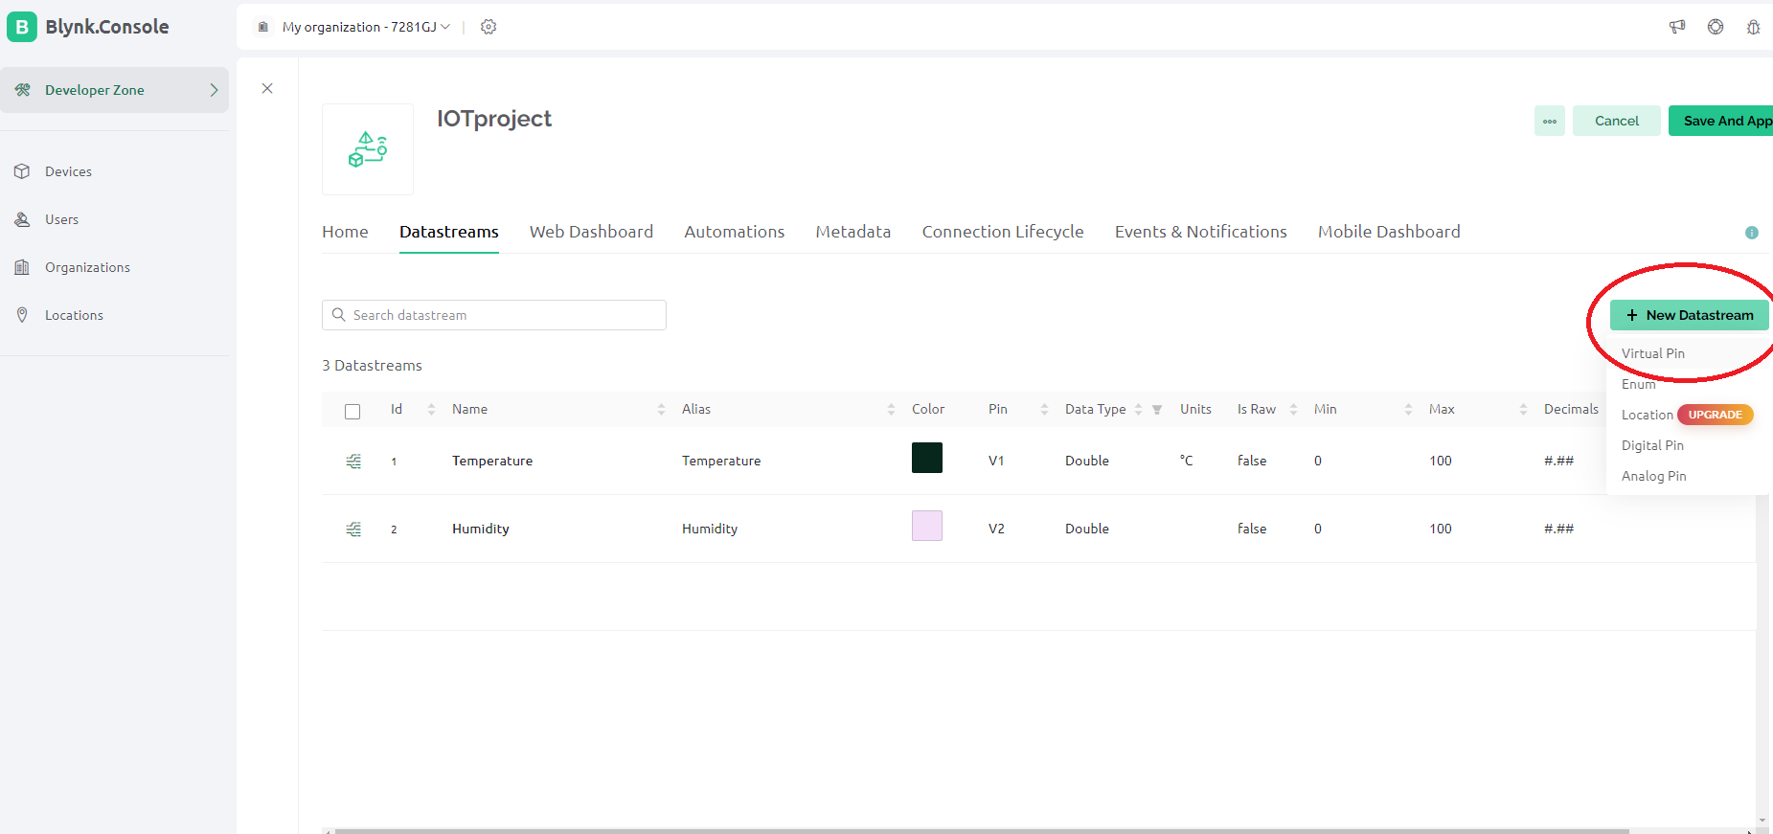
Blynk Website - https://blynk.io/
BLYNK IoT Web
Blynk is a tool that lets you connect and control devices, like lights or robots, using buttons and screens on your phone or computer.
>>>> click “New Datastream”
>>>> Then click ‘’Virtual Pin’’

Slide 25
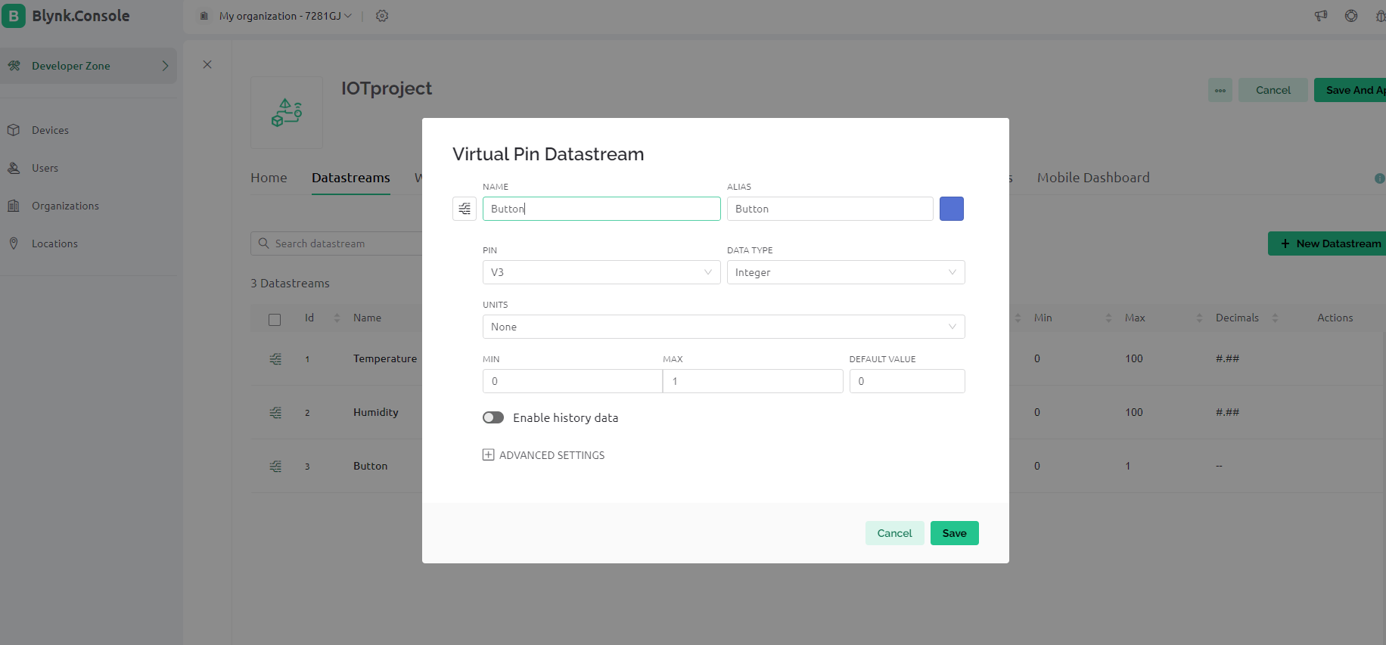
Blynk Website - https://blynk.io/
BLYNK IoT Web
Blynk is a tool that lets you connect and control devices, like lights or robots, using buttons and screens on your phone or computer.
In Datastream tab
>>>> Type your “Data name”
>>>> Select your “Data type”
>>>> Select your Data’s “unit”
>>>> Type “min & max” value
>>>> Then click “Create”

Slide 26
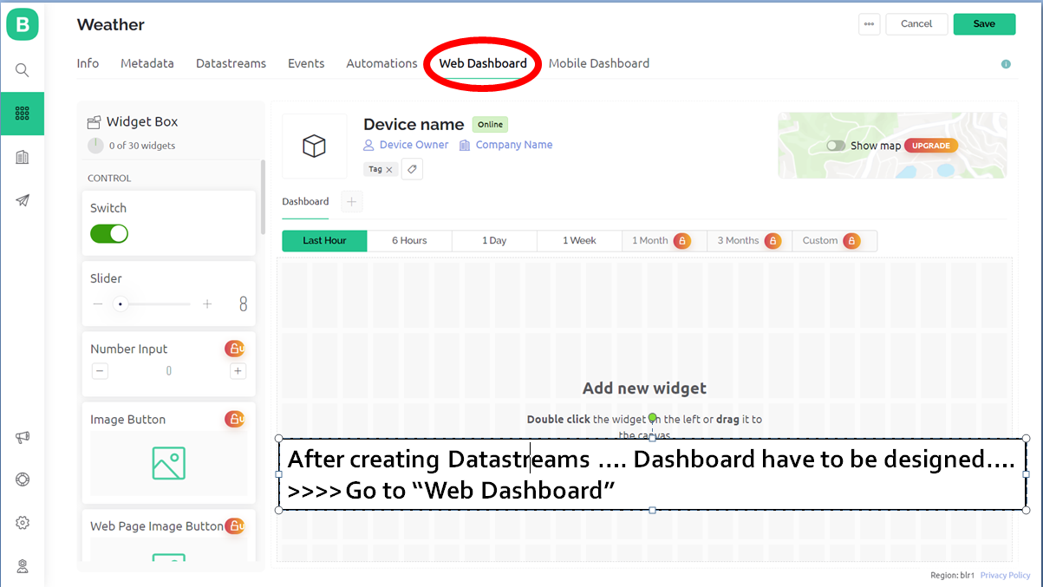
Blynk Website - https://blynk.io/
BLYNK IoT Web
Blynk is a tool that lets you connect and control devices, like lights or robots, using buttons and screens on your phone or computer.

Slide 27
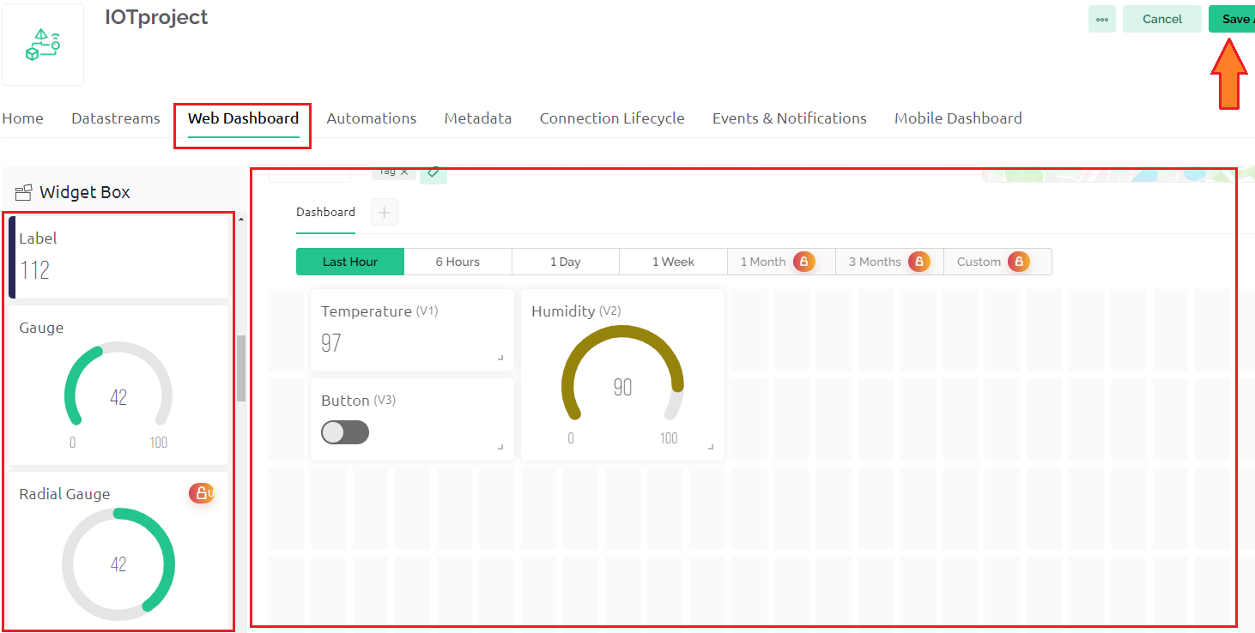
Blynk Website - https://blynk.io/
BLYNK IoT Web
Blynk is a tool that lets you connect and control devices, like lights or robots, using buttons and screens on your phone or computer.
For design dashboard choose wanted widgets
>>>> Select “Label, Gauge and Button”

Slide 28
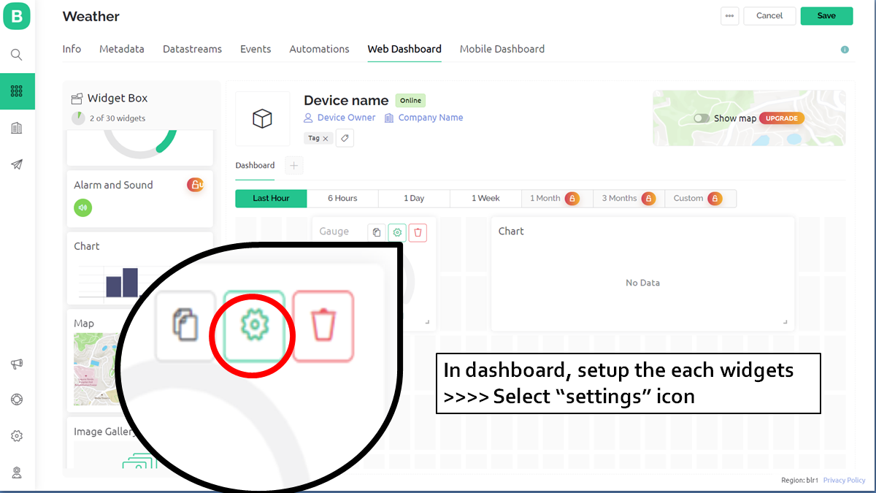
Blynk Website - https://blynk.io/
BLYNK IoT Web
Blynk is a tool that lets you connect and control devices, like lights or robots, using buttons and screens on your phone or computer.

Slide 29
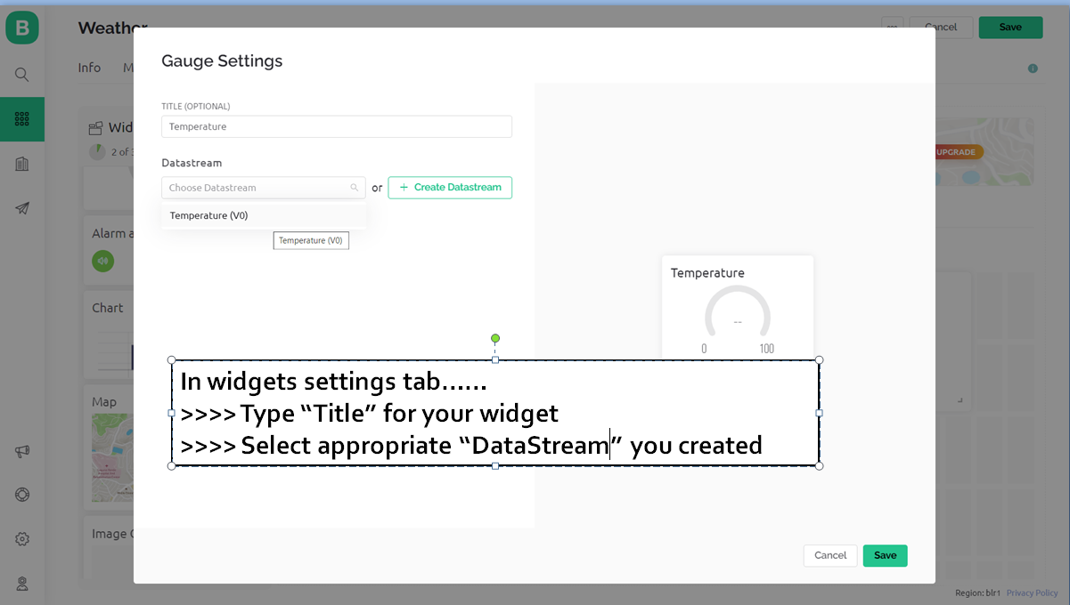
Blynk Website - https://blynk.io/
BLYNK IoT Web
Blynk is a tool that lets you connect and control devices, like lights or robots, using buttons and screens on your phone or computer.

Slide 30
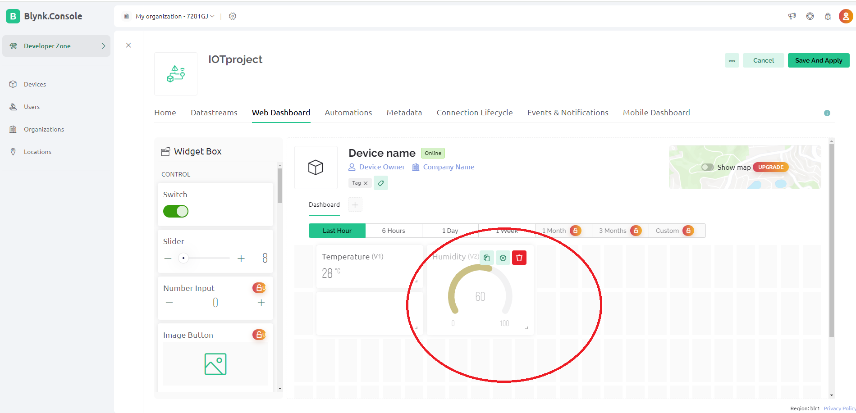
Blynk Website - https://blynk.io/
BLYNK IoT Web
Blynk is a tool that lets you connect and control devices, like lights or robots, using buttons and screens on your phone or computer.

Slide 31
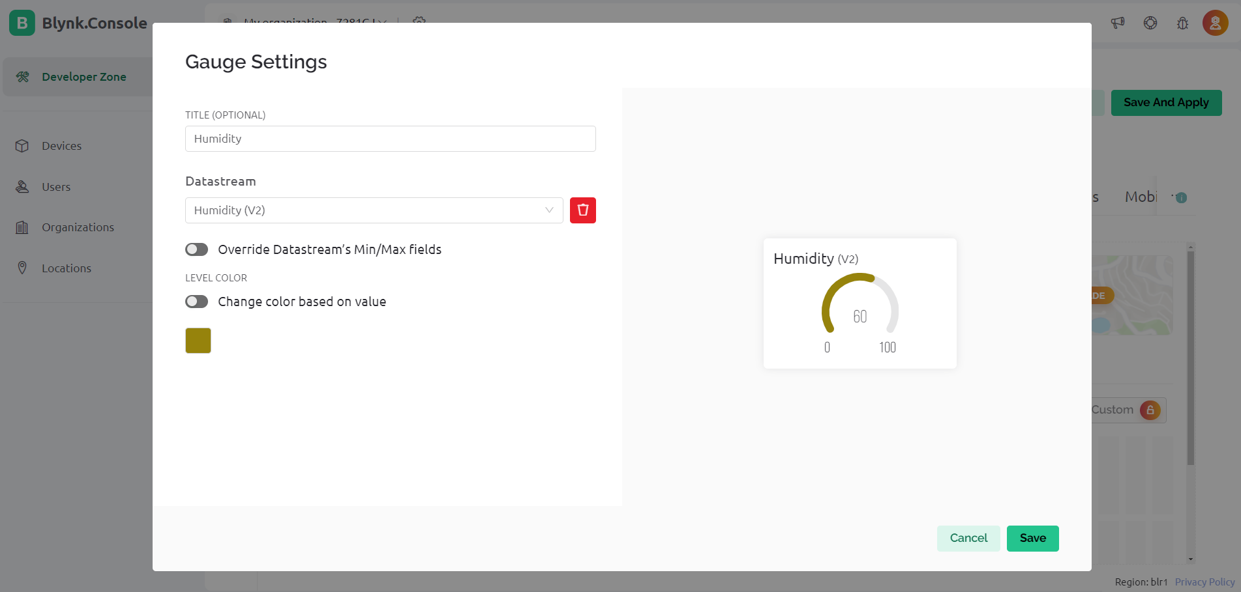
Blynk Website - https://blynk.io/
BLYNK IoT Web
Blynk is a tool that lets you connect and control devices, like lights or robots, using buttons and screens on your phone or computer.
In widgets settings tab……
>>>> Type “Title” for your widget
>>>> Select appropriate “DataStream” you created

Slide 32
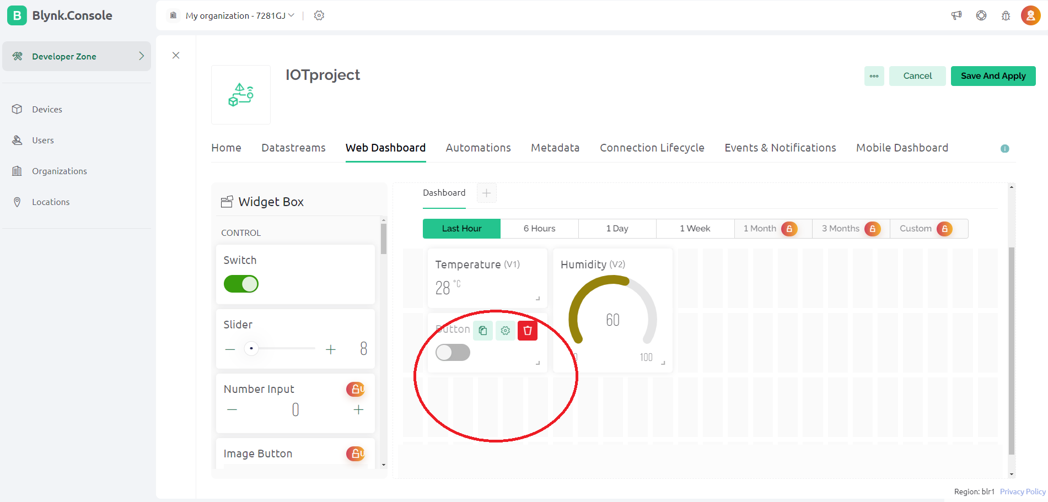
Blynk Website - https://blynk.io/
BLYNK IoT Web
Blynk is a tool that lets you connect and control devices, like lights or robots, using buttons and screens on your phone or computer.

Slide 33
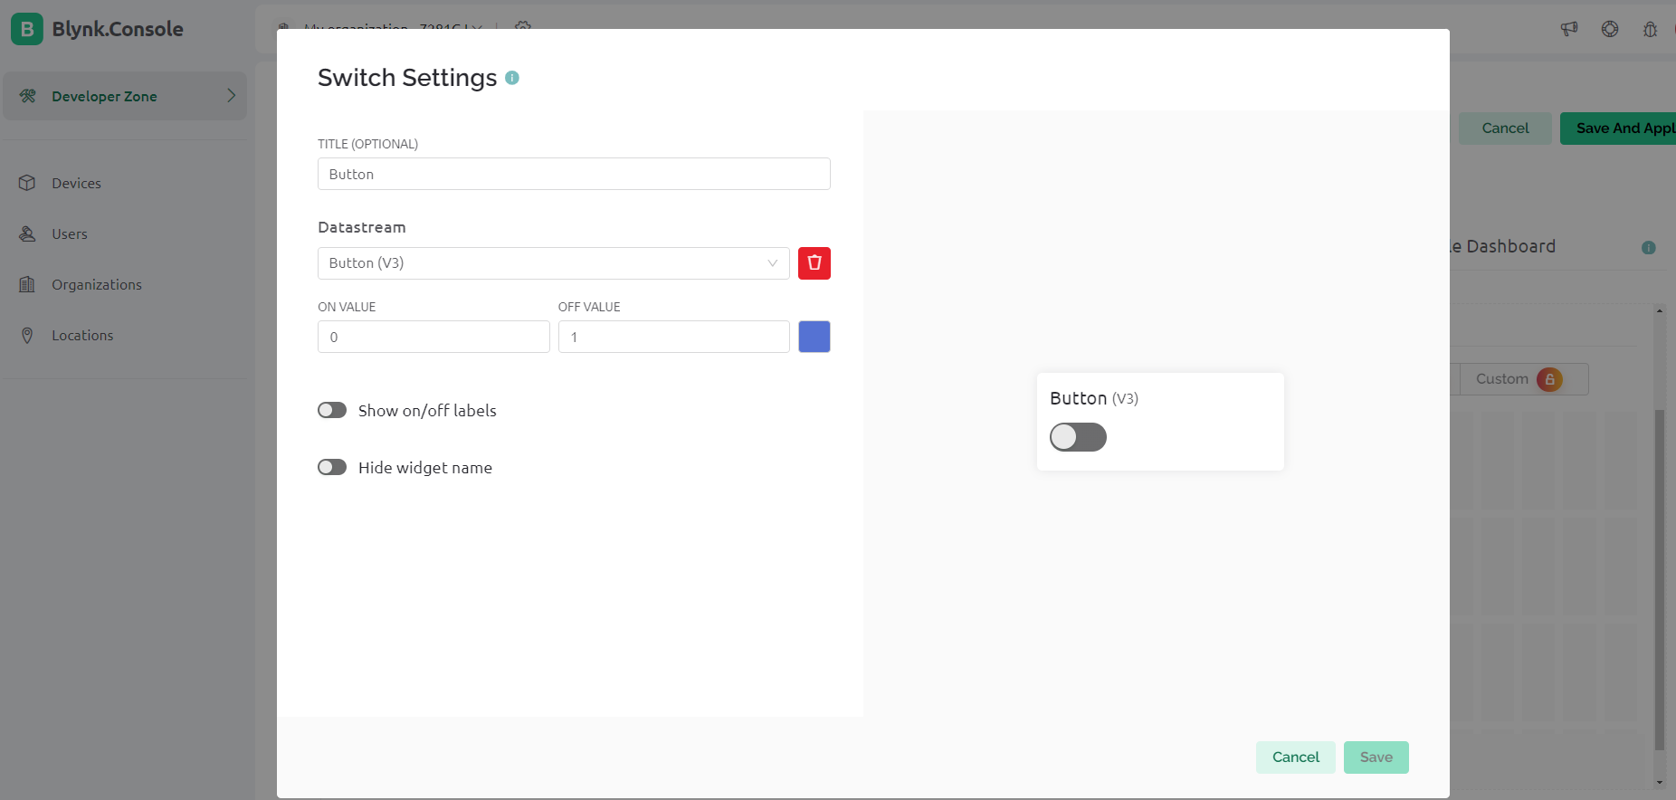
Blynk Website - https://blynk.io/
BLYNK IoT Web
Blynk is a tool that lets you connect and control devices, like lights or robots, using buttons and screens on your phone or computer.
In widgets settings tab……
>>>> Type “Title” for your Button
>>>> Select appropriate “DataStream” you created

Slide 34
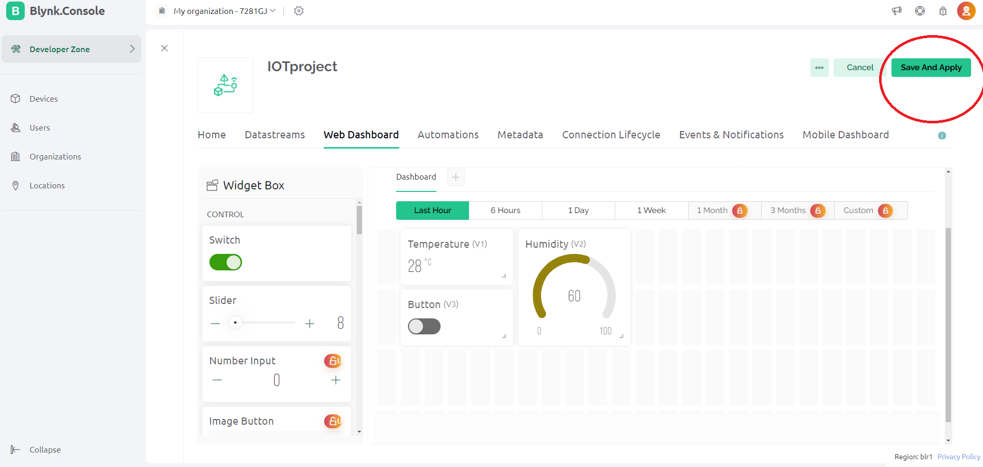
Blynk Website - https://blynk.io/
BLYNK IoT Web
Blynk is a tool that lets you connect and control devices, like lights or robots, using buttons and screens on your phone or computer.
After widgets settings were completed , widgets will starts work…
>>>> Then click “Save”

Slide 35
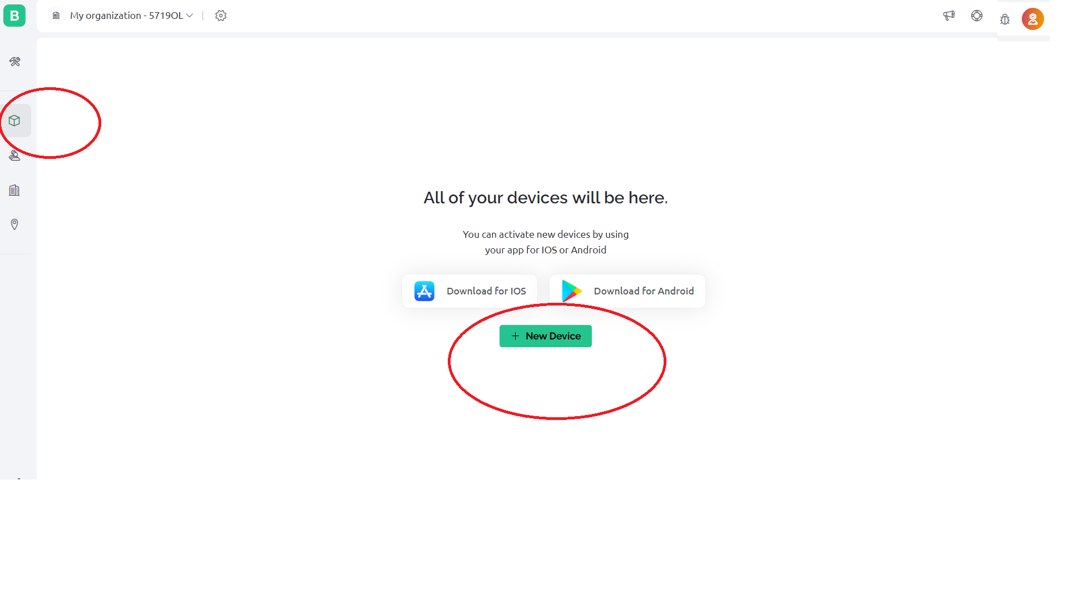
Blynk Website - https://blynk.io/
BLYNK IoT Web
Blynk is a tool that lets you connect and control devices, like lights or robots, using buttons and screens on your phone or computer.
Go to Devics Icon >>>> And click “+New Device ”

Slide 36
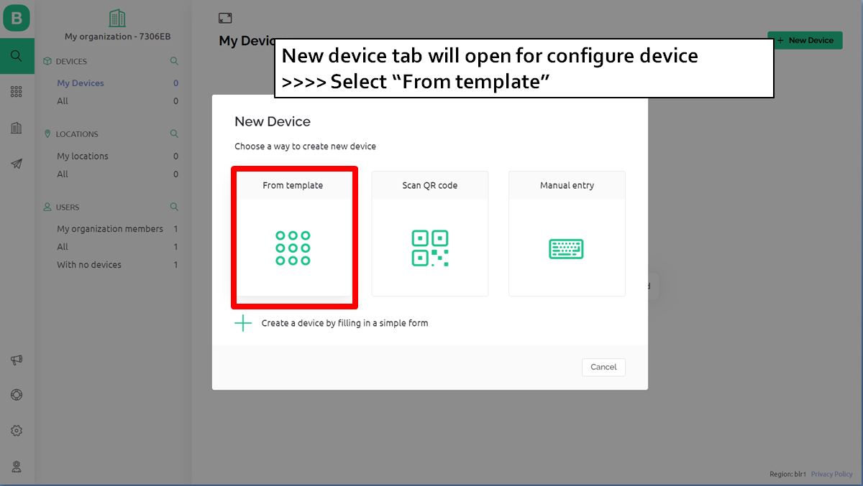
Blynk Website - https://blynk.io/
BLYNK IoT Web
Blynk is a tool that lets you connect and control devices, like lights or robots, using buttons and screens on your phone or computer.

Slide 37
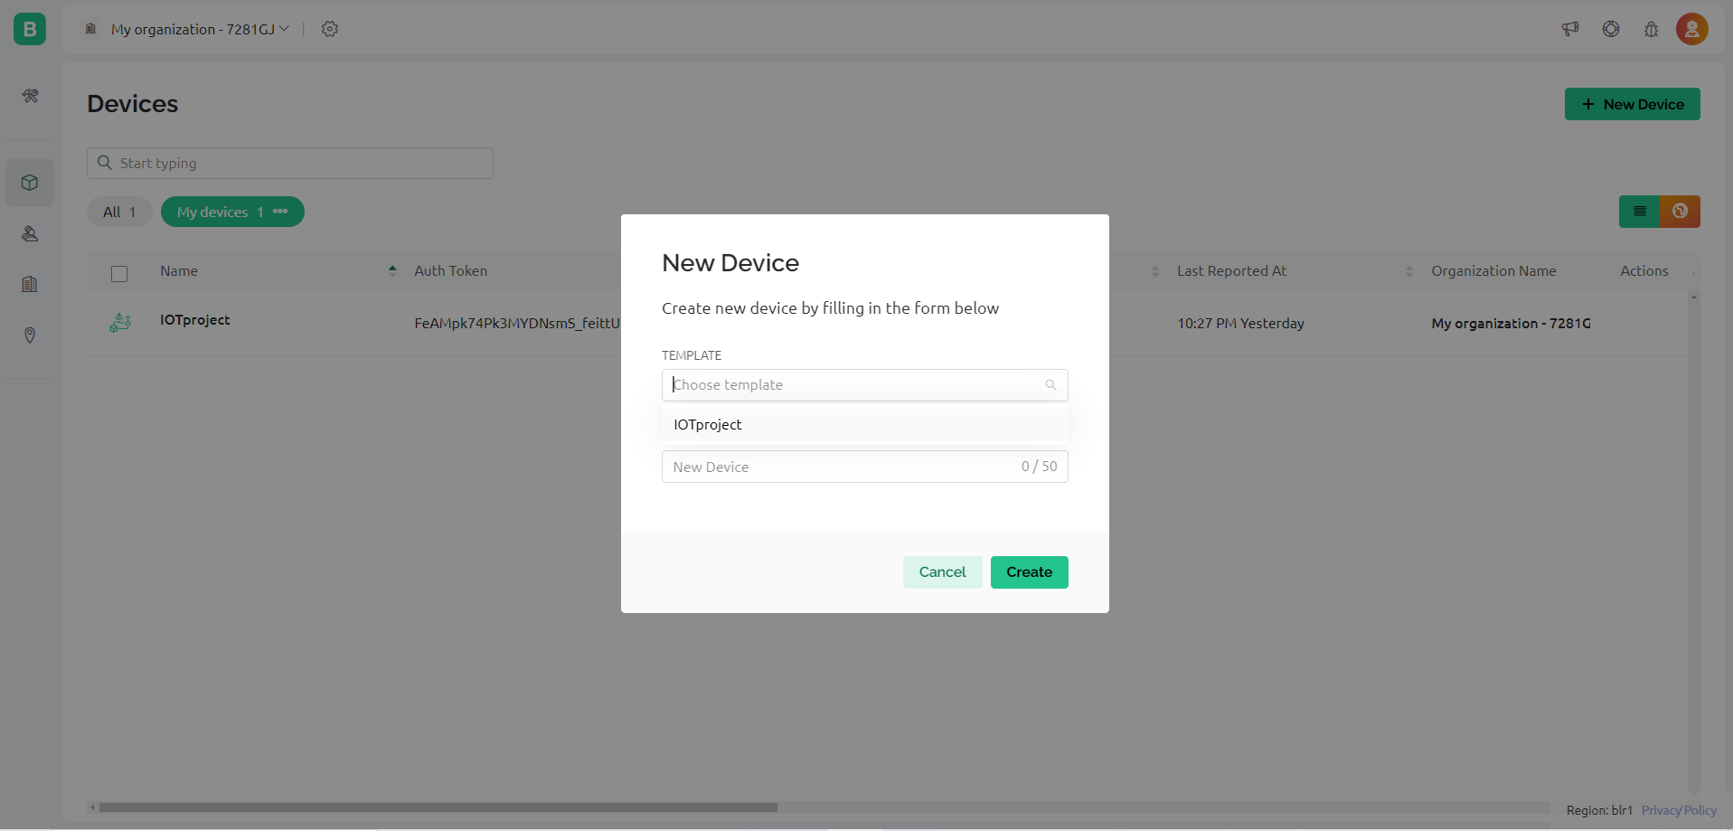
Blynk Website - https://blynk.io/
BLYNK IoT Web
Blynk is a tool that lets you connect and control devices, like lights or robots, using buttons and screens on your phone or computer.
>>>> Then select your “Template”
>>>> Then click “Create”

Slide 38
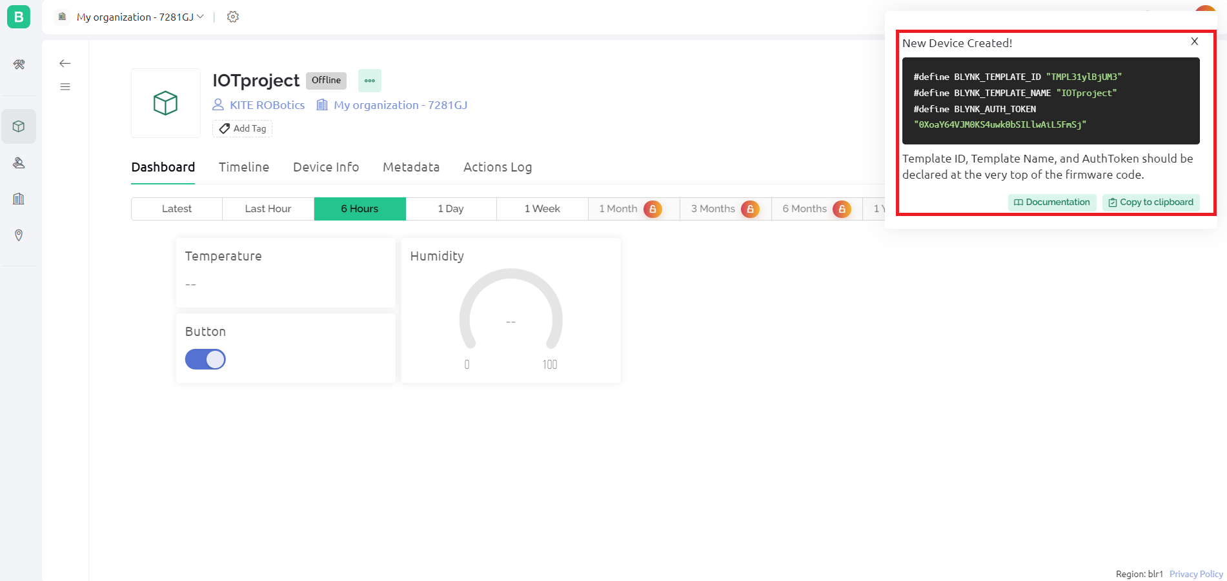
Blynk Website - https://blynk.io/
BLYNK IoT Web
Blynk is a tool that lets you connect and control devices, like lights or robots, using buttons and screens on your phone or computer.
Now your web dashboard is created successfully
>>>> Copy firmware configuration code

Slide 39
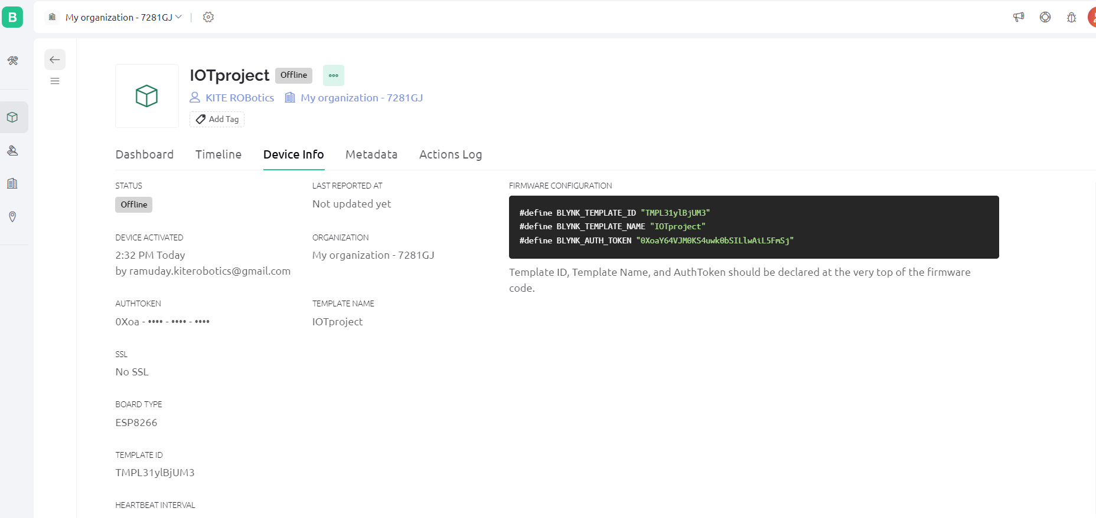
Blynk Website - https://blynk.io/
BLYNK IoT Web
Blynk is a tool that lets you connect and control devices, like lights or robots, using buttons and screens on your phone or computer.
>>>> Go to “Device info”
>>>> Copy FIRMWARE CONFIGURATION code
>>>> Paste the code in your Arduino code

Slide 40
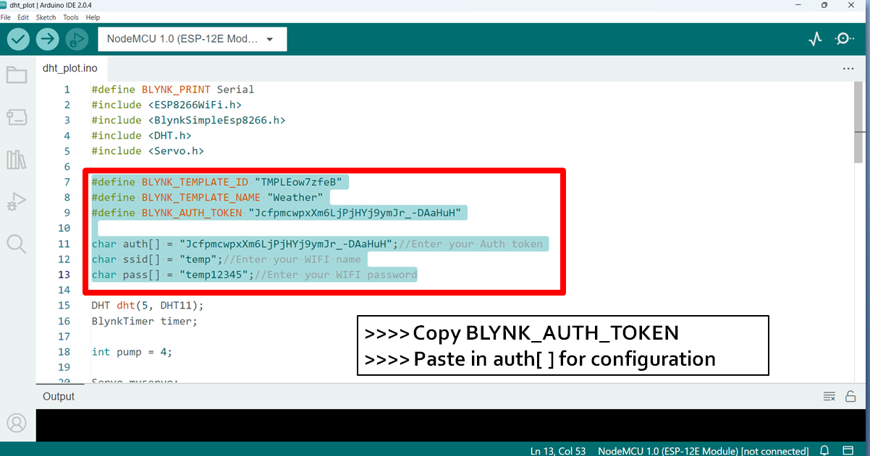
Blynk Website - https://blynk.io/
BLYNK IoT Web
Blynk is a tool that lets you connect and control devices, like lights or robots, using buttons and screens on your phone or computer.

Slide 41
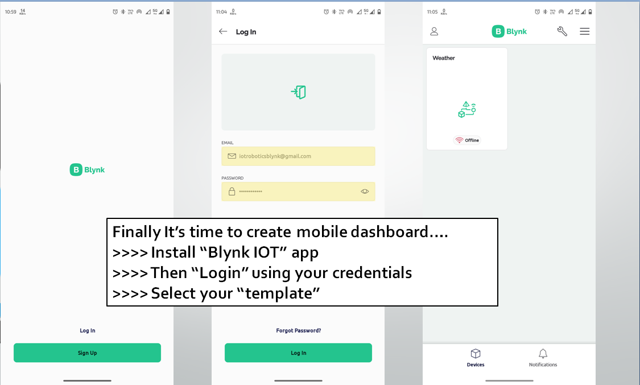
Blynk Website - https://blynk.io/
BLYNK IoT Web
Blynk is a tool that lets you connect and control devices, like lights or robots, using buttons and screens on your phone or computer.

Slide 42
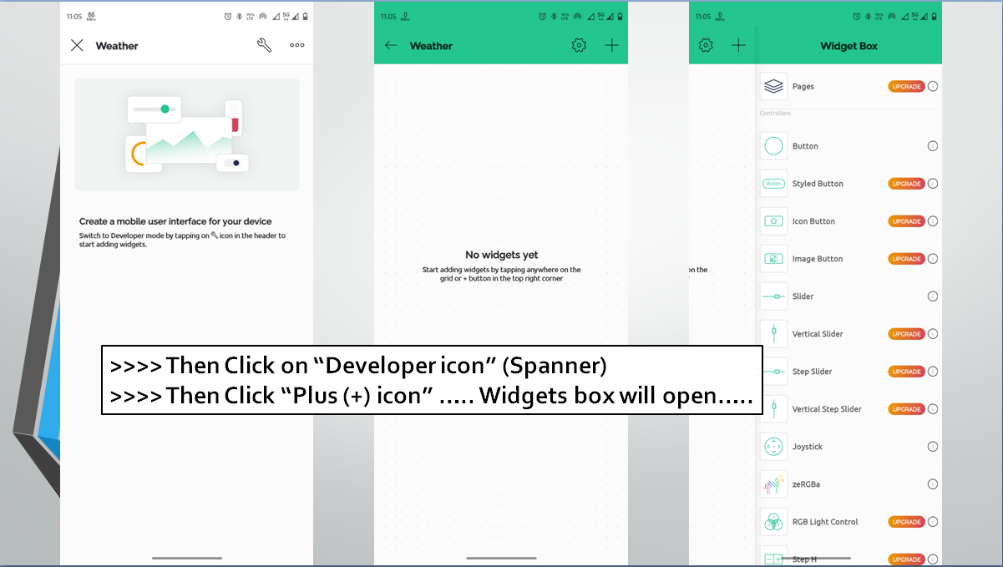
Blynk Website - https://blynk.io/
BLYNK IoT Web
Blynk is a tool that lets you connect and control devices, like lights or robots, using buttons and screens on your phone or computer.

Slide 43
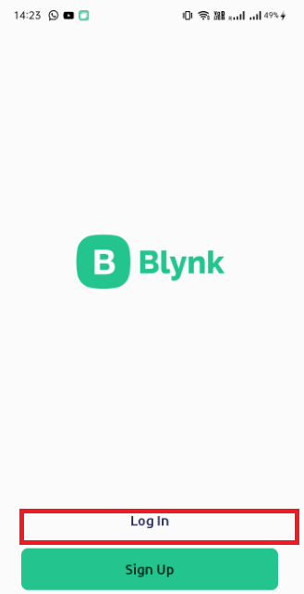
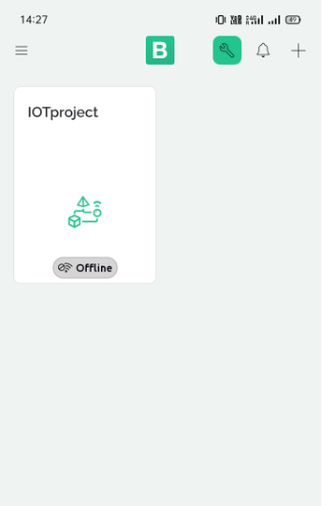
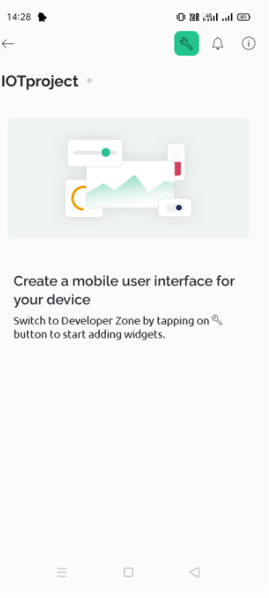















RESOURCE PAGE
USE SAME ID OR PASS WHICH
ONE YOU USED FOR BLYNK WEBSITE

Slide 44





Slide 45





Slide 46





Slide 47



Slide 48


Slide 49



Slide 50


